Slide 1

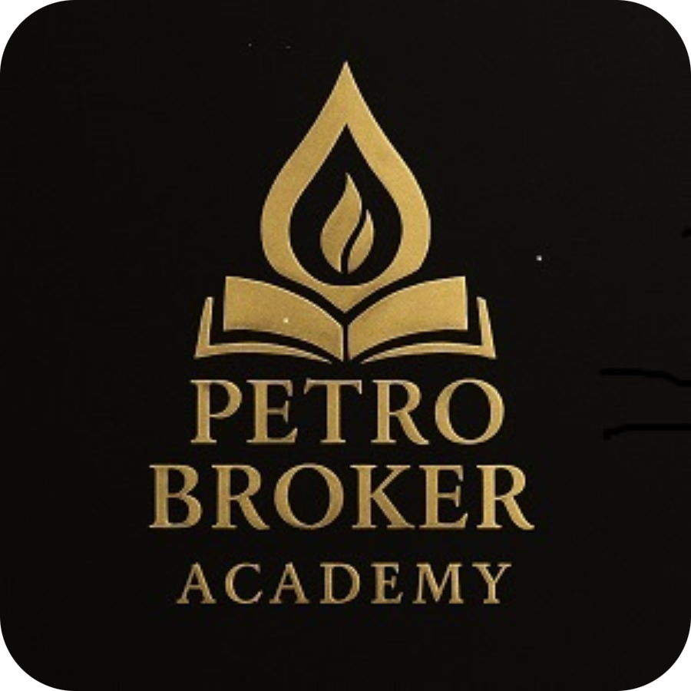

PETRO BROKER ACADEMY®
Professional Petroleum Brokerage & Energy Transaction Training
KNOWLEDGE DRIVES ENERGY
Founder: Mohammad Akhbari

Slide 2


About PETRO BROKER ACADEMY®
Who We Are
Industry Focus
A professional energy knowledge platform combining petroleum brokerage expertise, transaction frameworks, documentation standards, and international energy business networking — not merely an educational institute.
International crude oil & refined product transactions, petroleum brokerage operations, energy business development, KYC & due diligence, and cross-border energy trade facilitation.
Global Reach
Mission
Serving oil & gas companies, petroleum traders, energy professionals, strategic partners, and investors across international markets — with a commitment to professional standards at every level.
To equip energy professionals, brokers, buyers, and sellers with structured knowledge, verified methodologies, and professional frameworks that elevate the quality and integrity of international petroleum transactions.
Vision
To build a more transparent, educated, and professional global petroleum brokerage ecosystem — where every transaction is guided by verified standards, qualified counterparties, and sound documentation.

Slide 3

Founder Profile: Mohammad Akhbari
The Academy was established by a practitioner with deep, multi-sector experience across the international energy industry — bringing real-world expertise to every program and framework.
Oil & Gas Projects
Transaction Management
Extensive background in international oil & gas project development, spanning upstream, midstream, and downstream sectors across multiple jurisdictions.
Deep expertise in structuring, coordinating, and managing complex international petroleum transactions — from initial inquiry through final delivery.
International Standards
Business Development
Proficient in applying globally recognized frameworks for energy trade, including documentation protocols, compliance requirements, and counterparty verification standards.
Proven track record in building professional networks, identifying strategic opportunities, and developing business relationships within the global energy sector.
Founding Vision: PETRO BROKER ACADEMY® was established to address a critical gap in the petroleum brokerage industry — the absence of structured, professional knowledge systems accessible to practitioners worldwide.

Slide 4
Industry Challenges: A Market in Need of Standards
Lack of Professional Standards
1
The global petroleum brokerage space operates largely without universally accepted professional standards, creating inconsistency, reputational risk, and failed transactions across markets.
Documentation Risks
2
Poorly structured or fraudulent documentation — including fake LOIs, unverified FCOs, and non-compliant SPA drafts — exposes buyers, sellers, and brokers to significant legal and financial liability.
Unverified Counterparties
3
The proliferation of unqualified intermediaries, mandate chains, and unverified principals creates systemic trust deficits that derail legitimate transactions and damage industry credibility.
Transaction Complexity
4
International petroleum deals involve multi-jurisdictional legal frameworks, banking instruments (LC, SBLC, MT103), inspection protocols, and logistics coordination — complexity most brokers are ill-equipped to navigate.
Market Impact
5
These challenges collectively result in billions of dollars in failed or fraudulent transactions annually, undermining confidence in petroleum brokerage as a professional discipline.

Slide 5





Our Solutions: A Professional Knowledge Platform
Petroleum Brokerage Training
Transaction Execution Framework
KYC & Due Diligence
Structured, practitioner-grade training programs covering the full lifecycle of petroleum brokerage — from market fundamentals to advanced transaction management.
Systematic counterparty verification protocols aligned with international compliance standards — enabling professionals to qualify buyers, sellers, and mandates with confidence.
A proprietary, step-by-step methodology for executing international petroleum transactions with discipline, clarity, and professional rigor.
Documentation Systems
Professional Energy Networking
Comprehensive knowledge of petroleum trade documentation — LOI, ICPO, FCO, SPA, NCNDA, and banking instruments — with guidance on structure, sequencing, and red-flag identification.
Access to a curated network of verified energy professionals, brokers, mandates, buyers, sellers, and strategic partners operating across international petroleum markets.

Slide 6

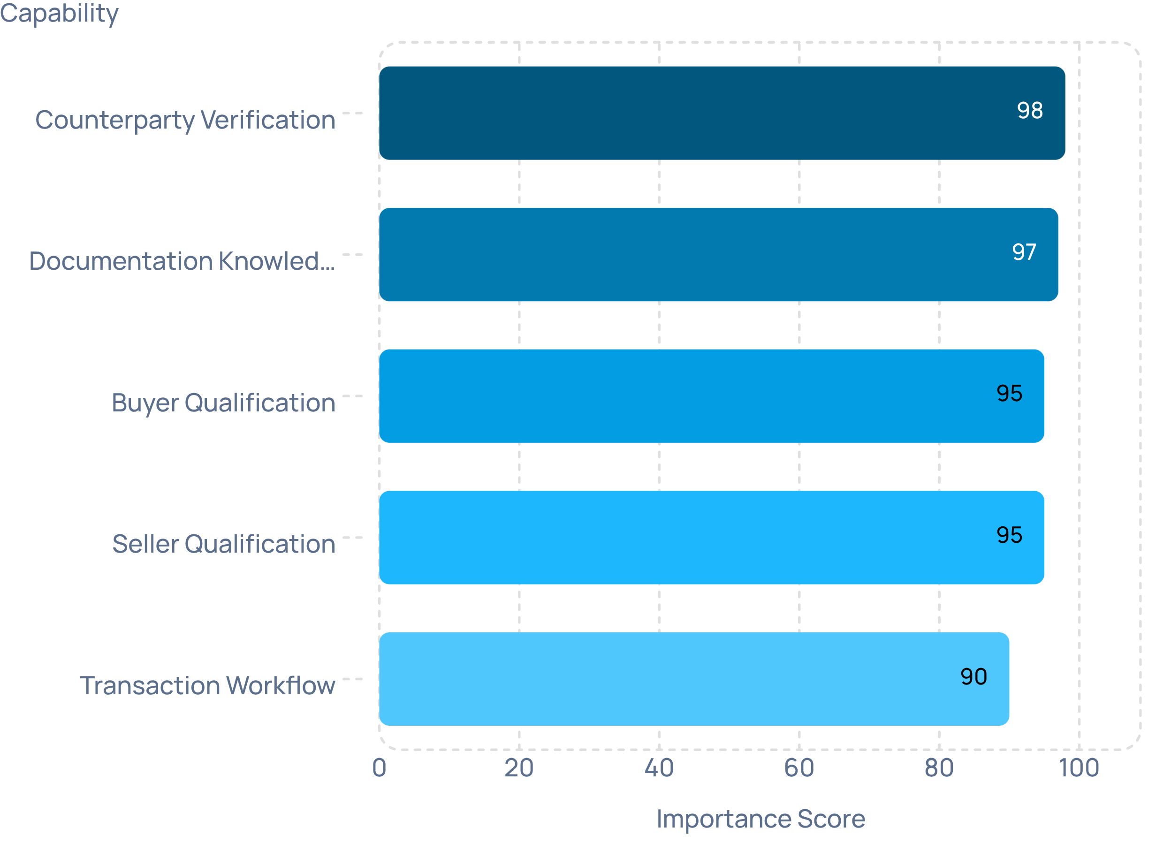


Core Capabilities
Five equally critical capability pillars that together form a complete petroleum brokerage competency framework — each essential to executing transactions with integrity and professional discipline.
Buyer Qualification
Seller Qualification
Structured assessment of buyer credibility, financial capacity, and transaction readiness — reducing exposure to non-performing or fraudulent counterparties.
Verification of seller mandates, product availability, and authorization to sell — ensuring principals are legitimate and transactions are executable.
Counterparty Verification
Transaction Workflow Management
Multi-layer due diligence covering corporate registration, banking relationships, track record, and compliance status across jurisdictions.
End-to-end process mapping for petroleum deals — from initial contact and NDA execution through product verification, contract signing, and payment settlement.
Petroleum Documentation Knowledge
Expert-level understanding of the full documentation stack required for compliant, bankable, and legally sound international petroleum transactions.
All five capability pillars score above 90 — reflecting the non-negotiable importance of each discipline within a complete petroleum brokerage competency framework.

Slide 7



Training Programs
Petroleum Trading Fundamentals
International Petroleum Transactions
Brokerage Practices
Professional standards for petroleum brokers — role definition, mandate verification, commission structures, chain-of-title management, and ethical conduct in multi-party transactions.
Core concepts of crude oil and refined product markets — pricing benchmarks (Brent, WTI, Dubai), trade routes, Incoterms, and market dynamics.
Advanced module covering the full transaction lifecycle — from RFQ and offer submission through contract negotiation, banking instrument coordination, and delivery confirmation.
Energy Documentation
Compliance Awareness
In-depth training on petroleum trade documents — purpose, structure, sequencing, and common fraud indicators across LOI, ICPO, FCO, SPA, NCNDA, and related instruments.
International sanctions regimes, AML/KYC obligations, OFAC and EU compliance requirements, and best practices for maintaining regulatory integrity in cross-border energy trade.

Slide 8
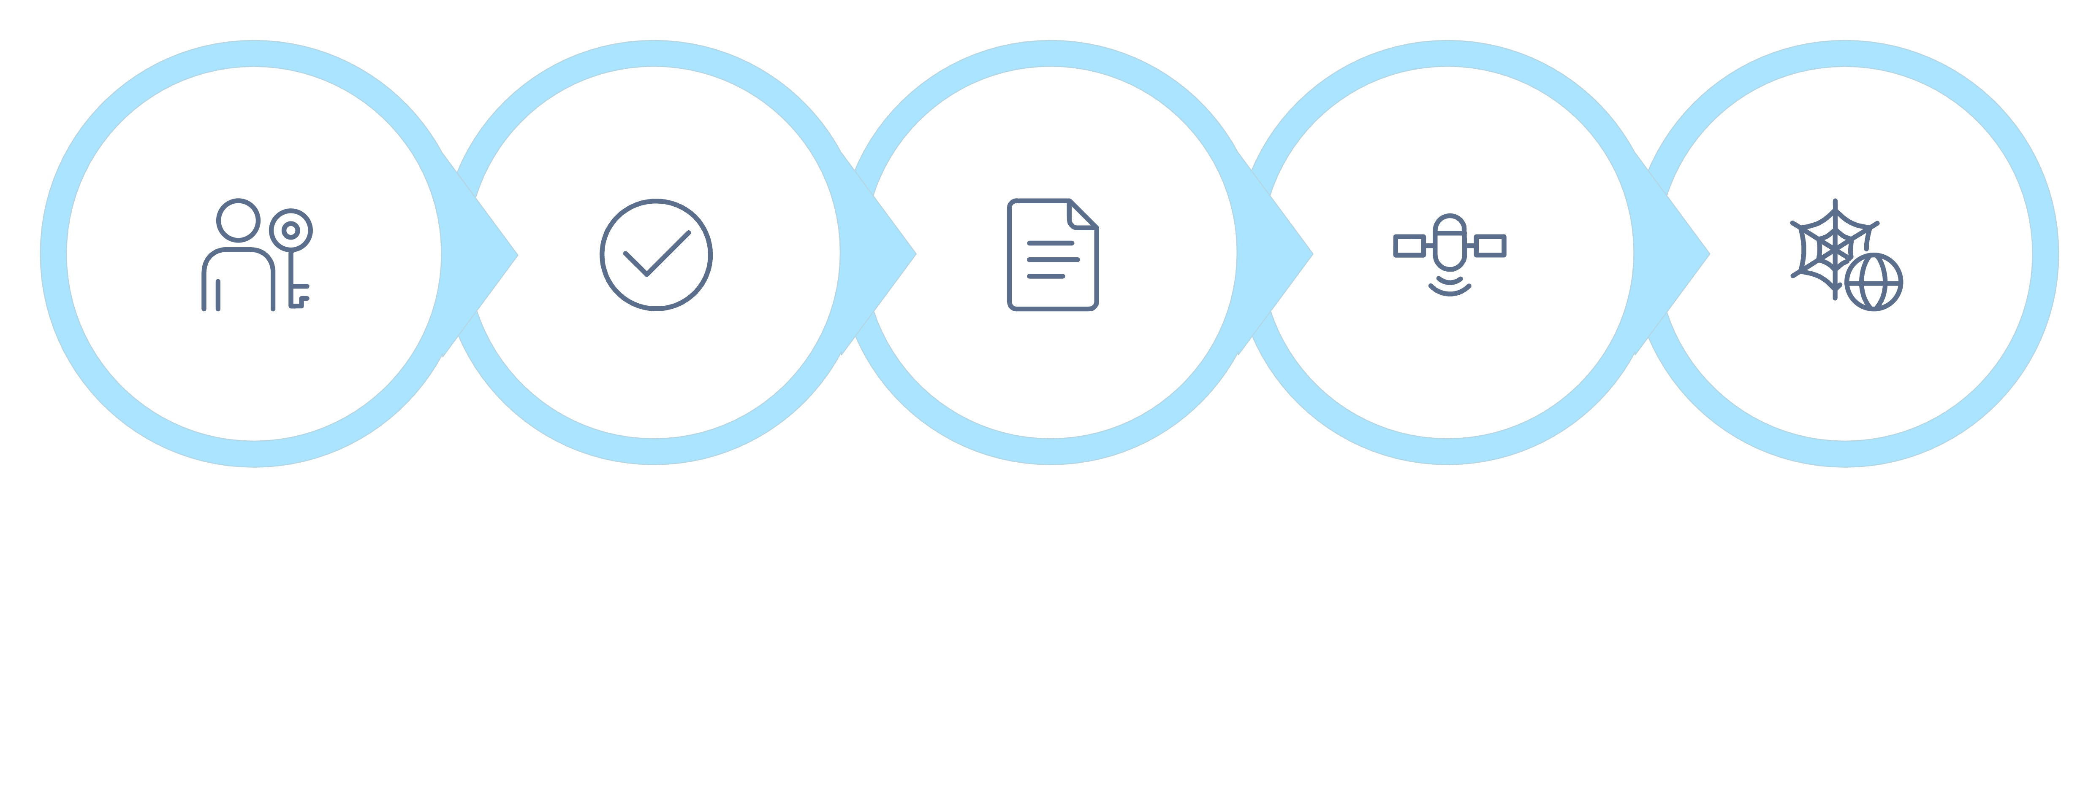
Transaction Execution Framework
A structured, five-phase methodology for executing international petroleum transactions with professional discipline — designed to eliminate ambiguity, reduce risk, and ensure every deal is managed to the highest standard.
1
Opportunity Assessment
Evaluate transaction viability — product type, volume, origin, pricing, and counterparty profile — before committing resources or advancing documentation.
2
Verification
Conduct systematic KYC and due diligence on all principals — buyers, sellers, mandates, and facilitators — using structured verification protocols and document authentication.
3
Documentation Review
Assess the completeness, sequencing, and legal soundness of all transaction documents — identifying gaps, inconsistencies, or red flags before proceeding.
4
Communication Management
Maintain structured, professional communication channels between all parties — managing information flow, expectation alignment, and confidentiality throughout the transaction.
5
Transaction Coordination
Orchestrate the final execution phase — contract finalization, banking instrument activation, product inspection, and delivery coordination — ensuring all parties fulfill their obligations.
Documentation
Communication
Coordination
Opportunity
Verification

Slide 9
Industry Network
Energy Professionals
Brokers & Mandates
A growing community of qualified petroleum industry practitioners — traders, analysts, consultants, and operations specialists — connected through the PETRO BROKER ACADEMY® platform.
Verified petroleum brokers and authorized mandates operating across key energy markets, connected through a framework that emphasizes credibility, transparency, and professional conduct.
Buyers & Sellers
Strategic Partners
Qualified end-buyers and verified sellers — including refineries, trading houses, NOCs, and independent operators — seeking structured, professional transaction environments.
Relationships with legal advisors, compliance specialists, inspection companies, logistics providers, and financial institutions that support the full petroleum transaction ecosystem.
Network Value: The PETRO BROKER ACADEMY® network is built on verified credentials, professional standards, and shared commitment to transaction integrity — creating a trusted environment for international energy business.

Slide 10






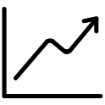
Why Partner with PETRO BROKER ACADEMY®
Credibility & Trust
Risk Reduction
Professional Development
Association with a professional knowledge platform that upholds rigorous standards signals commitment to transaction integrity — a critical differentiator in international petroleum markets.
Access to structured KYC methodologies, documentation frameworks, and counterparty verification tools directly reduces exposure to fraud, failed transactions, and compliance violations.
Equip your team with practitioner-grade knowledge across petroleum trading, brokerage, documentation, and compliance — building internal capability that delivers long-term competitive advantage.
Network Access
Strategic Alignment
Connect with a curated ecosystem of verified energy professionals, qualified counterparties, and strategic partners operating across international petroleum markets.
For investors and institutional partners, PETRO BROKER ACADEMY® represents a first-mover position in the professionalization of global petroleum brokerage — a market segment with significant growth potential.

Slide 11

Vision & Future Development
PETRO BROKER ACADEMY® is positioned to become the definitive international knowledge platform for petroleum brokerage professionals — setting the standard for how energy transactions are structured, verified, and executed worldwide.
Global Knowledge Platform
1
Establishing PETRO BROKER ACADEMY® as the definitive international standard for petroleum brokerage knowledge and professional practice.
2
Certification Framework
Development of internationally recognized professional certification programs for petroleum brokers, mandates, and energy transaction specialists.
Digital Infrastructure
3
Building proprietary digital tools for transaction workflow management, counterparty verification, and documentation compliance — extending the platform's value into active deal support.
4
Geographic Expansion
Extending reach across the Middle East, Africa, Asia-Pacific, and European energy markets — establishing regional hubs and local partnerships to serve the global petroleum brokerage community.
Industry Advocacy
5
Engaging with international energy bodies, trade associations, and regulatory stakeholders to advance the professionalization of petroleum brokerage as a recognized discipline within the global energy sector.
PETRO BROKER ACADEMY® — Knowledge Drives Energy. For partnership inquiries, training engagements, and strategic collaboration, connect with our team through official channels. Founder: Mohammad Akhbari

